Slide 1
Module 4.1
Memory Management

Slide 2
Memory Management
Background
Memory Hierarchy
Memory Allocation Techniques
Fragmentation
Segmentation
Paging
TLB

Slide 3
Objectives
To provide a detailed description of various ways of organizing memory hardware
To discuss various memory-management techniques, including paging and segmentation
To provide a detailed description of the Intel Pentium, which supports both pure segmentation and segmentation with paging

Slide 4
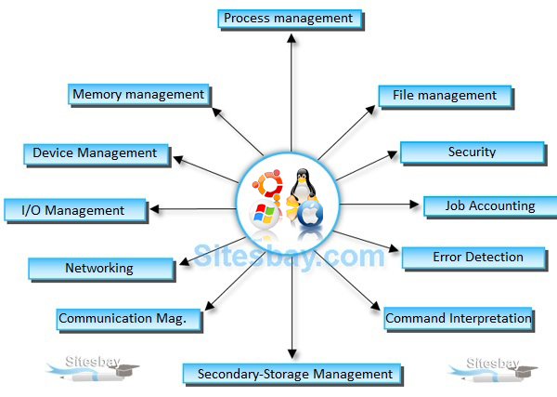
Introduction

Slide 5
Background
Program must be brought (from disk) into memory and placed within a process for it to be run
Main memory and registers are only storage CPU can access directly
Memory unit only sees a stream of addresses + read requests, or address + data and write requests
Register access in one CPU clock (or less)
Main memory can take many cycles, causing a stall
Cache sits between main memory and CPU registers
Protection of memory required to ensure correct operation

Slide 6
Background
Why Memory Management is required:
Allocate and de-allocate memory before and after process execution.
To minimize fragmentation issues.
To proper utilization of main memory.
To maintain data integrity while executing of process.
Goals?

Slide 7
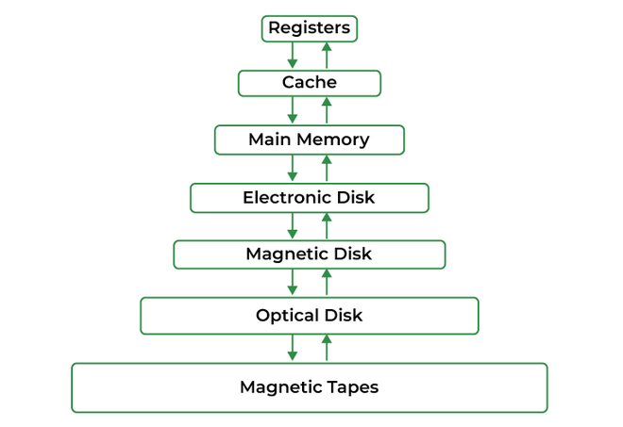
Memory hierarchy

Slide 8
Memory Management
3 criteria's:
Size
Access Time
Per unit cost
Ideally programmers want memory that is
• large
• fast
• non volatile
• Memory hierarchy
• small amount of fast, expensive memory – cache
• some medium-speed, medium price main memory
• gigabytes of slow, cheap disk storage
• Memory manager handles the memory hierarchy

Slide 9
Memory Management Techniques
Contiguous Memory :
It allows to store the process only in a contiguous fashion.
Thus, entire process has to be stored as a single entity at one place inside the memory.
Non- Contiguous Memory :
the program is divided into different blocks and loaded at different portions of the memory that need not necessarily be adjacent to one another. This scheme can be classified depending upon the size of blocks and whether the blocks reside in the main memory or not.

Slide 10
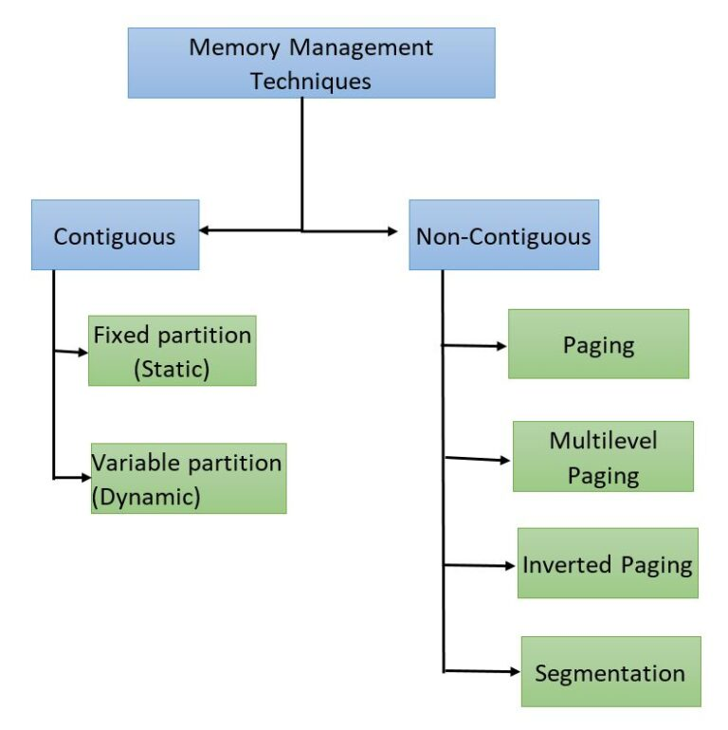

Slide 11
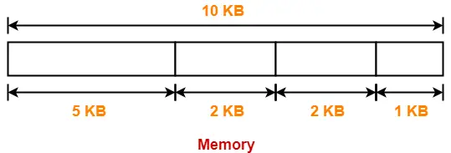
Memory Management Techniques
Contiguous Memory Management can be categorized in two:
Fixed Partition Scheme:
Memory is divided into fixed number of partitions. Fixed means number of partitions are fixed in the memory.
In the fixed partition, in every partition only one process will be accommodated. Maximum size of the process is restricted by maximum size of the partition. Every partition is associated with the limit registers.

Slide 12
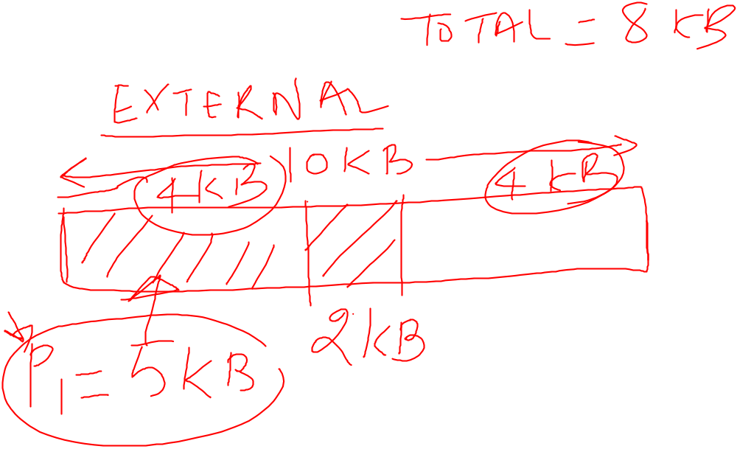

Slide 13
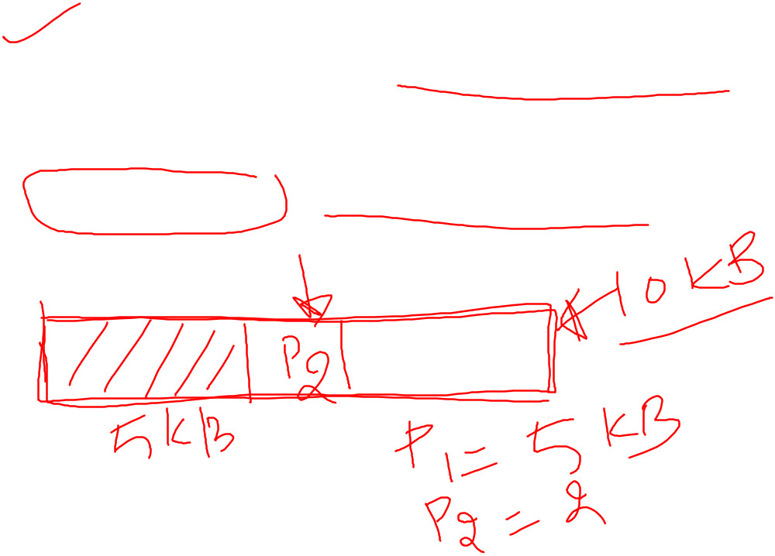
Memory Management Techniques
Variable Partition Scheme:
In the variable partition scheme, initially memory will be single continuous free block. Whenever the request by the process arrives, accordingly partition will be made in the memory. If the smaller processes keep on coming then the larger partitions will be made into smaller partitions.
External Fragmentation is found in variable partition scheme.

Slide 14
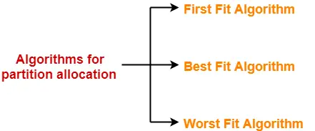
Algorithms for Partition Allocation-

Slide 15
Problem-01:
Consider six memory partitions of size 200 KB, 400 KB, 600 KB, 500 KB, 300 KB and 250 KB. These partitions need to be allocated to four processes of sizes 357 KB, 210 KB, 468 KB and 491 KB in that order.
Perform the allocation of processes using-
First Fit Algorithm
Best Fit Algorithm
Worst Fit Algorithm

Slide 16
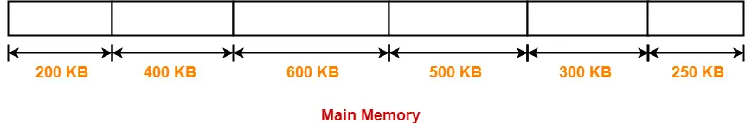
Solution
The main memory has been divided into fixed size partitions as-
Let us say the given processes are-
Process P1 = 357 KB
Process P2 = 210 KB
Process P3 = 468 KB
Process P4 = 491 KB

Slide 17
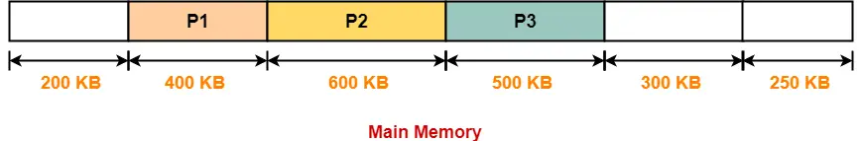
First Fit
In First Fit Algorithm,
Algorithm starts scanning the partitions serially.
When a partition big enough to store the process is found, it allocates that partition to the process.

Slide 18
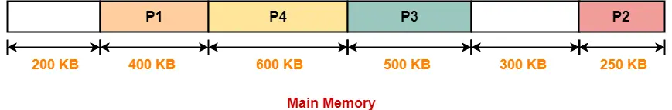
Best Fit
In Best Fit Algorithm,
Algorithm first scans all the partitions.
It then allocates the partition of smallest size that can store the process.

Slide 19
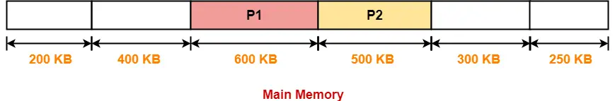
Worst fit
In Worst Fit Algorithm,
Algorithm first scans all the partitions.
It then allocates the partition of largest size to the process.

Slide 20
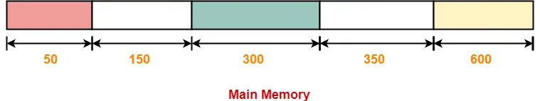
Problem 2 – variable size partitioning
Consider the following heap (figure) in which blank regions are not in use and hatched regions are in use-
The sequence of requests for blocks of size 300, 25, 125, 50 can be satisfied if we use-
Either first fit or best fit policy (any one)
First fit but not best fit policy
Best fit but not first fit policy
None of the above

Slide 21
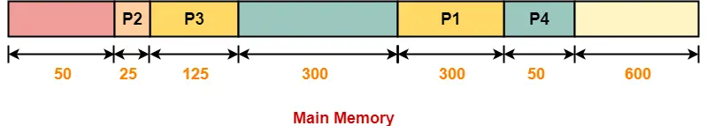
First fit

Slide 22
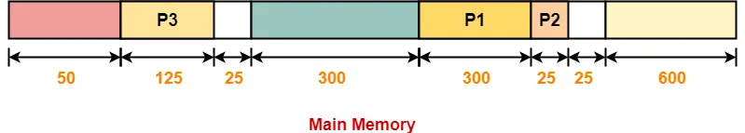
Best fit
Process P4 can not be allocated the memory.
This is because no partition of size greater than or equal to the size of process P4 is available.

Slide 23
Logical vs. Physical Address Space
The concept of a logical address space that is bound to a separate physical address space is central to proper memory management
  Logical address – generated by the CPU; also referred to as virtual address
  Physical address – address seen by the memory unit
Logical and physical addresses are the same in compile-time and load-time address-binding schemes; logical (virtual) and physical addresses differ in execution-time address-binding scheme
Logical address space is the set of all logical addresses generated by a program
Physical address space is the set of all physical addresses generated by a program

Slide 24
Memory-Management Unit (MMU)
Hardware device that at run time maps virtual to physical address
Many methods possible, covered in the rest of this chapter
To start, consider simple scheme where the value in the relocation register is added to every address generated by a user process at the time it is sent to memory
  Base register now called relocation register
  MS-DOS on Intel 80x86 used 4 relocation registers
The user program deals with logical addresses; it never sees the real physical addresses
  Execution-time binding occurs when reference is made to location in memory
  Logical address bound to physical addresses

Slide 25
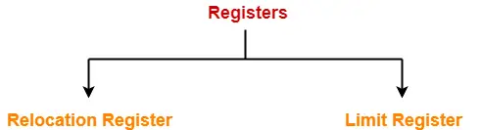
Address Translation
Translating Logical Address into Physical Address-
CPU always generates a logical address.
A physical address is needed to access the main memory.
Relocation Register stores the base address or starting address of the process in the main memory.
Limit Register stores the size or length of the process.

Slide 26

Hardware Support for Relocation and Limit Registers
Contiguous allocation

Slide 27
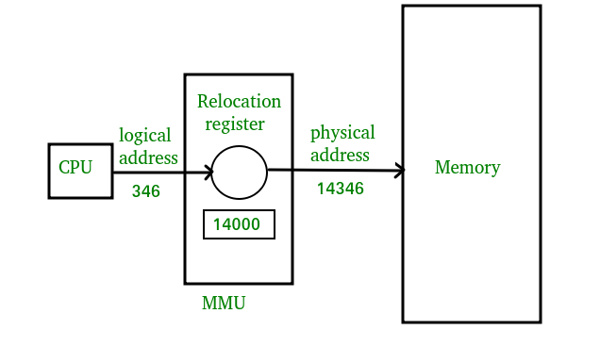
Address Translation

Slide 28
Paging
Physical address space of a process can be noncontiguous; process is allocated physical memory whenever the latter is available
  Avoids external fragmentation
  Avoids problem of varying sized memory chunks
Divide physical memory into fixed-sized blocks called frames
  Size is power of 2, between 512 bytes and 16 Mbytes
Divide logical memory into blocks of same size called pages
Keep track of all free frames
To run a program of size N pages, need to find N free frames and load program
Set up a page table to translate logical to physical addresses
Backing store likewise split into pages
Still have Internal fragmentation

Slide 29
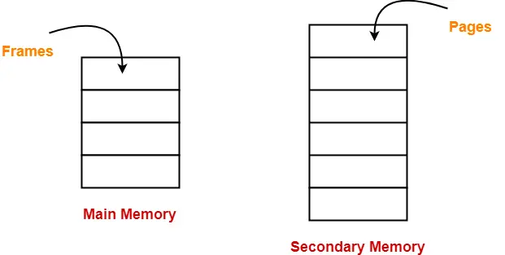
Paging
Paging is a fixed size partitioning scheme.
In paging, secondary memory and main memory are divided into equal fixed size partitions.
The partitions of secondary memory are called as pages.
The partitions of main memory are called as frames.

Slide 30
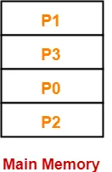
Paging
Consider a process is divided into 4 pages P0, P1, P2 and P3.
Depending upon the availability, these pages may be stored in the main memory frames in a non-contiguous fashion as shown-

Slide 31
Translating Logical Address into Physical Address-
CPU always generates a logical address.
A physical address is needed to access the main memory.
Following steps are followed to translate logical address into physical address-
Step-01:
CPU generates a logical address consisting of two parts-
Page Number
Page Offset
Step-02:
For the page number generated by the CPU,
Page Table provides the corresponding frame number (base address of the frame) where that page is stored in the main memory.

Slide 32
Translating Logical Address into Physical Address-
Step-03:
The frame number combined with the page offset forms the required physical address.
Frame number specifies the specific frame where the required page is stored.
Page Offset specifies the specific word that has to be read from that page.

Slide 33

Address Translation Scheme
Address generated by CPU is divided into:
  Page number (p) – used as an index into a page table which contains base address of each page in physical memory
  Page offset (d) – combined with base address to define the physical memory address that is sent to the memory unit
  For given logical address space 2^{m} and page size 2^{n}

Slide 34
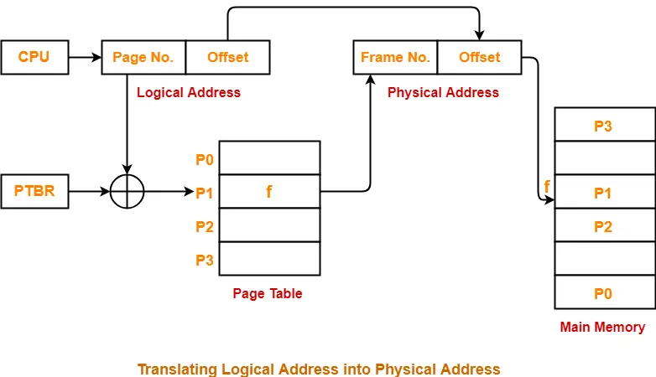
Paging Hardware
Holds the value of page table

Slide 35
Paging
Page Table-
Page table is a data structure.
It maps the page number referenced by the CPU to the frame number where that page is stored.
Characteristics-
Page table is stored in the main memory.
Number of entries in a page table = Number of pages in which the process is divided.
Page Table Base Register (PTBR) contains the base address of page table.
Each process has its own independent page table

Slide 36
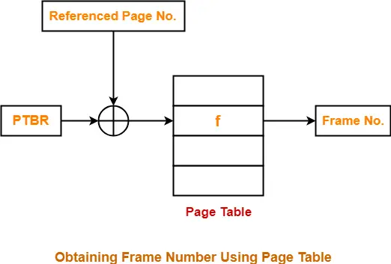
Page Table Working
The base address of the page table is added with the page number referenced by the CPU.
It gives the entry of the page table containing the frame number where the referenced page is stored.

Slide 37
Important points
Features of paging:
Mapping logical address to physical address.
Page size is equal to frame size.
Number of entries in a page table is equal to number of pages in logical address space.
The page table entry contains the frame number.
All the page table of the processes are placed in main memory.

Slide 38
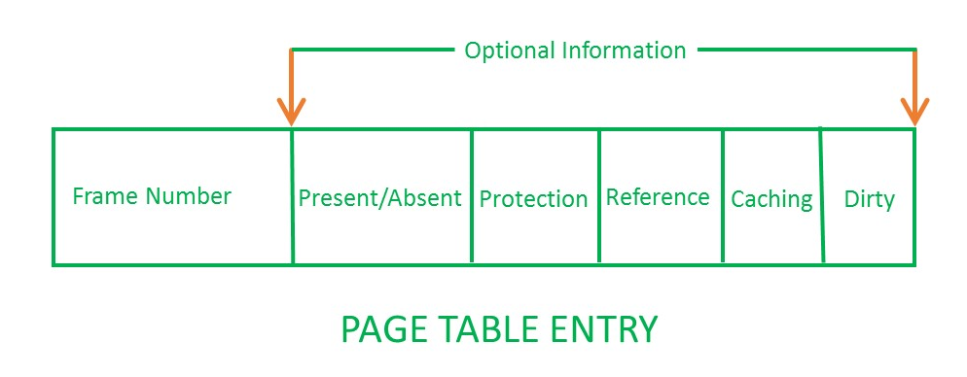
Page Table entry
Frame number:
It gives the frame number in which the current page you are looking for is present. The number of bits required depends on the number of frames.Frame bit is also known as address translation bit.
Number of bits for frame = Size of physical memory/frame size

Slide 39

Paging Model of Logical and Physical Memory

Slide 40

Paging Example
n=2 and m=4 32-byte memory and 4-byte pages

Slide 41
Important Formulas
For Main Memory-
Physical Address Space = Size of main memory
Size of main memory = Total number of frames x Page size
Frame size = Page size
If number of frames in main memory = 2X, then number of bits in frame number = X bits
If Page size = 2X Bytes, then number of bits in page offset = X bits
If size of main memory = 2X Bytes, then number of bits in physical address = X bits

Slide 42
Important Points
For Process-
Virtual Address Space = Size of process
Number of pages the process is divided = Process size / Page size
If process size = 2X bytes, then number of bits in virtual address space = X bits
For Page Table-
Size of page table = Number of entries in page table x Page table entry size
Number of entries in pages table = Number of pages the process is divided
Page table entry size = Number of bits in frame number + Number of bits used for optional fields if any

Slide 43
Problem 1
Find the size of the memory if its address consists of 22 bits. Assume the memory is 2-byte addressable.
We have-
Number of locations possible with 22 bits = 2²² locations
It is given that the size of one location = 2 bytes
Thus, Size of memory
= 2²² x 2 bytes
= 2²³ bytes
= 8 MB

Slide 44
Problem 2
Calculate the number of bits required in the address for memory having size of 16 GB. Assume the memory is 4-byte addressable.
Let ‘n’ number of bits are required. Then, Size of memory = 2^{n} x 4 bytes.
Since, the given memory has size of 16 GB, so we have-
2^{n} x 4 bytes = 16 GB
2^{n} x 4 = 16 G
2^{n} x 2² = 2³⁴
2^{n} = 2³²
∴ n = 32 bits

Slide 45
Problem 3
Consider a system with byte-addressable memory, logical address is 33bits, physical address is 24bits and size of page (total) is 2kb.
What will be the size of memory?
No. of bits in the offset
No. of pages & frames
No. of entries in page table = No. of pages in process
Size of the page table

Slide 46
Problem 3
S.M = 8GB
M.M = 16 MB
Size of page = 2kb
No. of bits = 11 bits
No. of bits in offset =11
P= 33-11 =22

Slide 47
Problem No. 4
Consider a system with byte-addressable memory, 32 bit logical addresses, 4 kilobyte page size and page table entries of 4 bytes each. Calculate size of page table.
Given-
Number of bits in logical address = 32 bits
Page size = 4KB
Page table entry size = 4 bytes

Slide 48
Solution
Number of entries in page table = 232 / 4Kbyte
= 232 / 212
= 220
Size of page table = (No. page table entries)*(Size of an entry)
= 220 * 4 bytes
= 222
= 4 Megabytes

Slide 49
Paging (Cont.)
Calculating internal fragmentation
  Page size = 2,048 bytes
  Process size = 72,766 bytes
  35 pages + 1,086 bytes
  Internal fragmentation of 2,048 - 1,086 = 962 bytes
  Worst case fragmentation = 1 frame – 1 byte
  On average fragmentation = 1 / 2 frame size
  So small frame sizes desirable?
  But each page table entry takes memory to track
  Page sizes growing over time
    Solaris supports two page sizes – 8 KB and 4 MB
Process view and physical memory now very different
By implementation process can only access its own memory

Slide 50

Free Frames
Before allocation
After allocation

Slide 51
Implementation of Page Table
Page table is kept in main memory
Page-table base register (PTBR) points to the page table
Page-table length register (PTLR) indicates size of the page table
In this scheme every data/instruction access requires two memory accesses
  One for the page table and one for the data / instruction
The two memory access problem can be solved by the use of a special fast-lookup hardware cache called associative memory or translation look-aside buffers (TLBs)

Slide 52
Implementation of Page Table (Cont.)
Some TLBs store address-space identifiers (ASIDs) in each TLB entry – uniquely identifies each process to provide address-space protection for that process
  Otherwise need to flush at every context switch
TLBs typically small (64 to 1,024 entries)
On a TLB miss, value is loaded into the TLB for faster access next time
  Replacement policies must be considered
  Some entries can be wired down for permanent fast access

Slide 53
Disadvantage Of Paging-
Disadvantage of paging
One major disadvantage of paging is-
It increases the effective access time due to increased number of memory accesses.
One memory access is required to get the frame number from the page table.
Another memory access is required to get the word from the page.

Slide 54
Optimal Page Size
In paging scheme, there are mainly two overheads-
1. Overhead of Page Tables-
Paging requires each process to maintain a page table.
So, there is an overhead of maintaining a page table for each process.
2. Overhead of Wasting Pages-
There is an overhead of wasting last page of each process if it is not completely filled.
On an average, half page is wasted for each process.
Thus,
Total overhead for one process
= Size of its page table + (Page size / 2)

Slide 55

Optimal Page Size
Optimal page size is the page size that minimizes the total overhead.

Slide 56
Problem 1
In a paging scheme, virtual address space is 4 KB and page table entry size is 8 bytes. What should be the optimal page size?
We know-
Optimal page size
= (2 x Process size x Page table entry size)1/2
= (2 x 4 KB x 8 bytes)1/2
= (216 bytes x bytes)1/2
= 28 bytes
= 256 bytes
Thus, Optimal page size = 256 bytes.

Slide 57
Problem 2
In a paging scheme, virtual address space is 256 GB and page table entry size is 32 bytes. What should be the optimal page size?
We know-
Optimal page size
= (2 x Process size x Page table entry size)^{1/2}
= (2 x 256 GB x 32 bytes)^{1/2}
= (2⁴⁴ bytes x bytes)^{1/2}
= 2²² bytes
= 4 MB
Thus, Optimal page size = 4 MB.

Slide 58
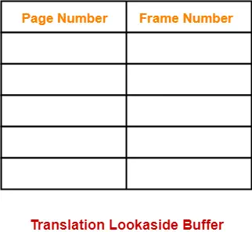
Translation Lookaside Buffer-
Translation Lookaside Buffer (TLB) is a solution that tries to reduce the effective access time.
Being a hardware, the access time of TLB is very less as compared to the main memory.
Structure-
Translation Lookaside Buffer (TLB) consists of two columns-
Page Number
Frame Number

Slide 59
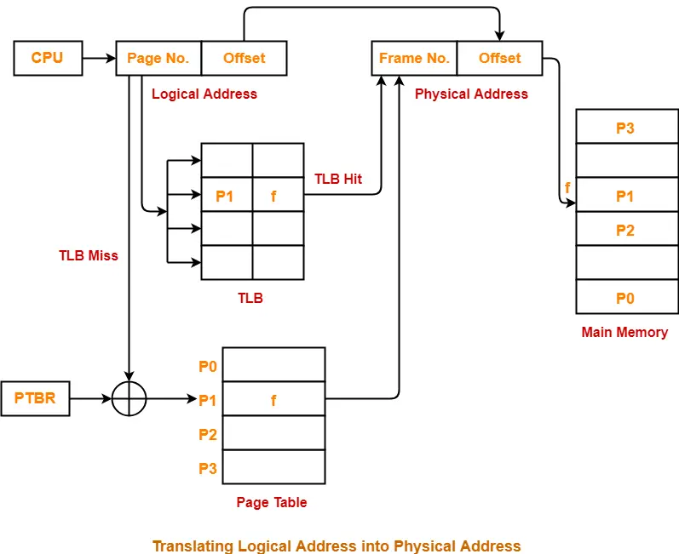
*Assume no page fault

Slide 60
TLB
Unlike page table, there exists only one TLB in the system.
So, whenever context switching occurs, the entire content of TLB is flushed and deleted.
TLB is then again updated with the currently running process.
When a new process gets scheduled-
Initially, TLB is empty. So, TLB misses are frequent.
With every access from the page table, TLB is updated.
After some time, TLB hits increases and TLB misses reduces.
The time taken to update TLB after getting the frame number from the page table is negligible.
Also, TLB is updated in parallel while fetching the word from the main memory.

Slide 61
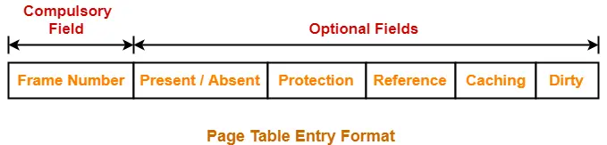
Page fault
When a page referenced by the CPU is not found in the main memory, it is called as a page fault.
When a page fault occurs, the required page has to be fetched from the secondary memory into the main memory.

Slide 62
Page Fault Handling Routine-
The following sequence of events take place-
The currently running process is stopped and context switching occurs.
The referenced page is copied from the secondary memory to the main memory.
If the main memory is already full, a page is replaced to create a room for the referenced page.
After copying the referenced page successfully in the main memory, the page table is updated.
When the execution of process is resumed, step-02 repeats.

Slide 63
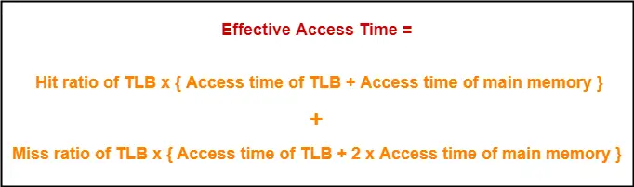
TLB
Effective Access Time-
In a single level paging using TLB, the effective access time is given as-
This formula is valid only when there is single level paging and there are no page faults.

Slide 64
TLB: Problem 1
A paging scheme uses a Translation Lookaside buffer (TLB). A TLB access takes 10 ns and a main memory access takes 50 ns. What is the effective access time (in ns) if the TLB hit ratio is 90% and there is no page fault?

Slide 65
Solution
Calculating TLB Miss Ratio-
TLB Miss ratio
= 1 – TLB Hit ratio
= 1 – 0.9
= 0.1
Calculating Effective Access Time-
Effective Access Time
= 0.9 x { 10 ns + 50 ns } + 0.1 x { 10 ns + 2 x 50 ns }
= 0.9 x 60 ns + 0.1 x 110 ns
= 54 ns + 11 ns
= 65 ns

Slide 66
TLB: Problem 2
A paging scheme uses a Translation Lookaside buffer (TLB). The effective memory access takes 160 ns and a main memory access takes 100 ns. What is the TLB access time (in ns) if the TLB hit ratio is 60% and there is no page fault?

Slide 67
Solution
Calculating TLB Miss Ratio-
TLB Miss ratio
= 1 – TLB Hit ratio
= 1 – 0.6
= 0.4
Calculating TLB Access Time-
Let TLB access time = T ns.
Substituting values in the above formula, we get-
160 ns = 0.6 x { T + 100 ns } + 0.4 x { T + 2 x 100 ns }
160 = 0.6 x T + 60 + 0.4 x T + 80
160 = T + 140
T = 160 – 140
T = 20

Slide 68
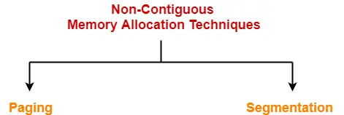
Segmentation-
Segmentation is a variable size partitioning scheme.
In segmentation, secondary memory and main memory are divided into partitions of unequal size.
The size of partitions depend on the length of modules.
The partitions of secondary memory are called as segments.

Slide 69
Segmentation
Memory-management scheme that supports user view of memory
A program is a collection of segments
  A segment is a logical unit such as:
main program
procedure
function
method
object
local variables, global variables
common block
stack
symbol table
arrays

Slide 70

User’s View of a Program

Slide 71
Logical View of Segmentation
1
1
4
2
3
4
2
3
user space
physical memory space

Slide 72
Segmentation Architecture
Logical address consists of a two tuple:
<segment-number, offset>,
Segment table – maps two-dimensional physical addresses; each table entry has:
  base – contains the starting physical address where the segments reside in memory
  limit – specifies the length of the segment
Segment-table base register (STBR) points to the segment table’s location in memory
Segment-table length register (STLR) indicates number of segments used by a program;
segment number s is legal if s < STLR

Slide 73
Segmentation Architecture (Cont.)
Protection
  With each entry in segment table associate:
    validation bit = 0 ⇒ illegal segment
    read/write/execute privileges
Protection bits associated with segments; code sharing occurs at segment level
Since segments vary in length, memory allocation is a dynamic storage-allocation problem
A segmentation example is shown in the following diagram

Slide 74
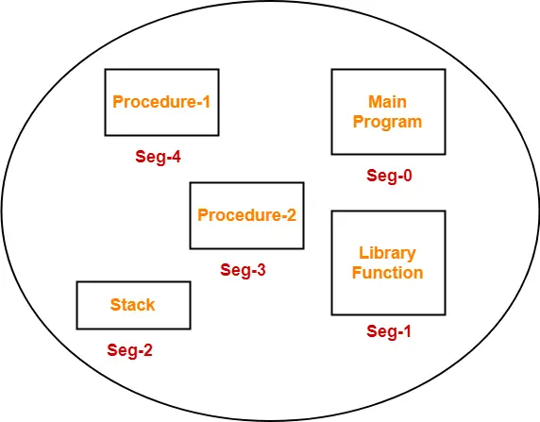
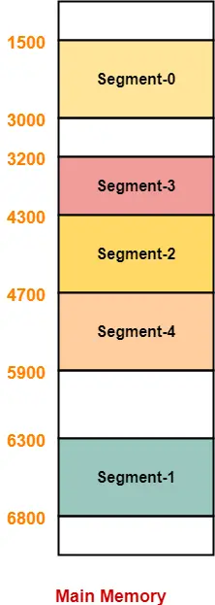
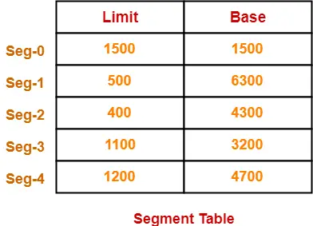

Slide 75
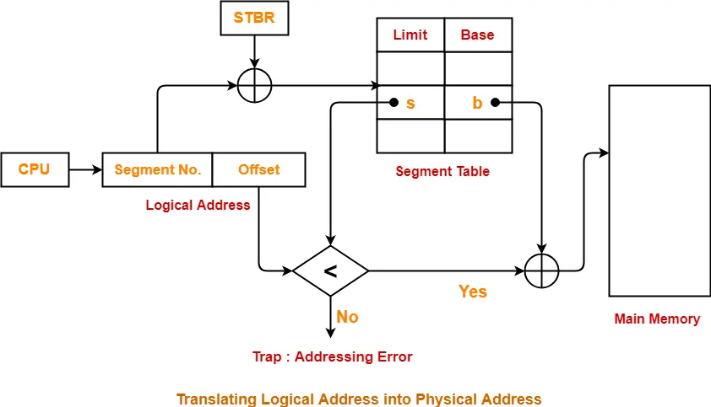
Segmentation Hardware

Slide 76
Segment Table-
Segment table is a table that stores the information about each segment of the process.
It has two columns.
First column stores the size or length of the segment.
Second column stores the base address or starting address of the segment in the main memory.
Segment table is stored as a separate segment in the main memory.
Segment table base register (STBR) stores the base address of the segment table.

Slide 77
PROBLEM BASED ON SEGMENTATION-
Segment No. | Base | Length
0 | 1219 | 700
1 | 2300 | 14
2 | 90 | 100
3 | 1327 | 580
4 | 1952 | 96
Which of the following logical address will produce trap addressing error?
0, 430
1, 11
2, 100
3, 425
4, 95
Calculate the physical address if no trap is produced.

Slide 78
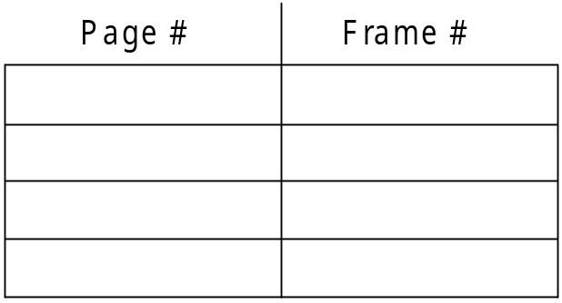
Associative Memory
Associative memory – parallel search
Address translation (p, d)
  If p is in associative register, get frame # out
  Otherwise get frame # from page table in memory

Slide 79

Paging Hardware With TLB

Slide 80
Effective Access Time
Associative Lookup = ε time unit
  Can be < 10% of memory access time
Hit ratio = α
  Hit ratio – percentage of times that a page number is found in the associative registers; ratio related to number of associative registers
Consider α = 80%, ε = 20ns for TLB search, 100ns for memory access
Effective Access Time (EAT)
EAT = (1 + ε) α + (2 + ε)(1 – α)
= 2 + ε – α
Consider α = 80%, ε = 20ns for TLB search, 100ns for memory access
  EAT = 0.80 x 100 + 0.20 x 200 = 120ns
Consider more realistic hit ratio -> α = 99%, ε = 20ns for TLB search, 100ns for memory access
  EAT = 0.99 x 100 + 0.01 x 200 = 101ns

Slide 81
Memory Protection
Memory protection implemented by associating protection bit with each frame to indicate if read-only or read-write access is allowed
  Can also add more bits to indicate page execute-only, and so on
Valid-invalid bit attached to each entry in the page table:
  “valid” indicates that the associated page is in the process’ logical address space, and is thus a legal page
  “invalid” indicates that the page is not in the process’ logical address space
  Or use page-table length register (PTLR)
Any violations result in a trap to the kernel

Slide 82

Valid (v) or Invalid (i) Bit In A Page Table

Slide 83
Structure of the Page Table
Memory structures for paging can get huge using straight-forward methods
  Consider a 32-bit logical address space as on modern computers
  Page size of 4 KB (2¹²)
  Page table would have 1 million entries (2³² / 2¹²)
  If each entry is 4 bytes -> 4 MB of physical address space / memory for page table alone
    That amount of memory used to cost a lot
    Don’t want to allocate that contiguously in main memory

Slide 84
Swapping
A process can be swapped temporarily out of memory to a backing store, and then brought back into memory for continued execution
  Total physical memory space of processes can exceed physical memory
Backing store – fast disk large enough to accommodate copies of all memory images for all users; must provide direct access to these memory images
Roll out, roll in – swapping variant used for priority-based scheduling algorithms; lower-priority process is swapped out so higher-priority process can be loaded and executed
Major part of swap time is transfer time; total transfer time is directly proportional to the amount of memory swapped
System maintains a ready queue of ready-to-run processes which have memory images on disk

Slide 85
Swapping (Cont.)
Does the swapped out process need to swap back in to same physical addresses?
Depends on address binding method
  Plus consider pending I/O to / from process memory space
Modified versions of swapping are found on many systems (i.e., UNIX, Linux, and Windows)
  Swapping normally disabled
  Started if more than threshold amount of memory allocated
  Disabled again once memory demand reduced below threshold

Slide 86

Schematic View of Swapping

Slide 87
Context Switch Time including Swapping
If next processes to be put on CPU is not in memory, need to swap out a process and swap in target process
Context switch time can then be very high
100MB process swapping to hard disk with transfer rate of 50MB/sec
  Swap out time of 2000 ms
  Plus swap in of same sized process
  Total context switch swapping component time of 4000ms (4 seconds)
Can reduce if reduce size of memory swapped – by knowing how much memory really being used
  System calls to inform OS of memory use via request_memory() and release_memory()

Slide 88
Context Switch Time and Swapping (Cont.)
Other constraints as well on swapping
  Pending I/O – can’t swap out as I/O would occur to wrong process
  Or always transfer I/O to kernel space, then to I/O device
    Known as double buffering, adds overhead
Standard swapping not used in modern operating systems
  But modified version common
    Swap only when free memory extremely low

Slide 89
End of Chapter

